Slide 1

Let’s talk about impossible things….

Slide 2

When we want to express impossible or unlikely situations, we use SECOND CONDITIONAL.

Slide 3
Second conditional
Use Past Tenses in “if-clause”☺
Don’t forget about would in the main sentence.
Eg. If I went there, I would meet him.
If I were you, I would help my classmates.
Note: verb ‘to be’ in S.C. is WERE
in every person.

Slide 4
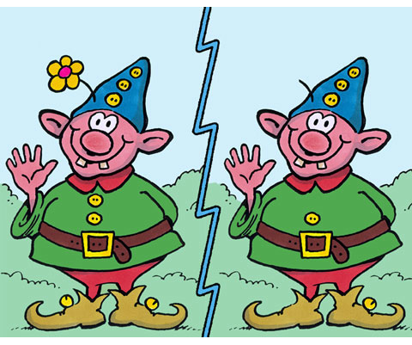
What’s the difference between…
Second Conditional (S.C)
If I had enough money, I would buy an expensive car.
(It’s just a dream, not very real. )
First Conditional (F.C)
If I have enough money, I will buy some shoes.
(It’s much more possible than the last situation)

Slide 5


If I had a lot of money,
I would travel around the world.

Slide 6
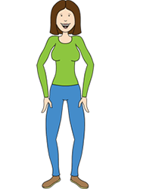


If she were taller,
she wouldn’t wear
high-heeled shoes.

Slide 7
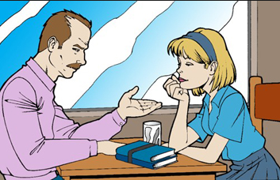
If I were you, I would stay
at home.

Slide 8

What would you…?

Slide 9

Choose one alternative…
If you could speak any other language which language would you like to speak?
A)English
B)French
C) Chinese
D)Portuguese
E) Italian
F) Another language.

Slide 10

Choose an alternative…
Your friend wrote something on the wall and you got blamed for it. What would you do?
A) Tell the teacher.
B) Say nothing and get punished.
C) Fight with your friend later.

Slide 11
Choose the correct variant
  If I would play/played the lottery, I would have/had a chance to hit the jackpot.
  If I would hit/hit the jackpot, I would be/were rich.
  If I would be/were rich, my life would change/changed completely.
  I would buy/bought a lonely island, if I would find/found a nice one.

Slide 12
Choose the correct variant
5. If I would own/owned a lonely island, I would build/built a huge house by the beach.
6. I would invite/invited all my friends if I would have/had a house by the beach.
7. I would pick/picked my friends up in my yatch if they would want/wanted to spend their holidays on my island.

Slide 13
Choose the correct variant
8. We would have/had great parties if my friends would come/came to my island.
9. If we would like/liked to go shopping in a big city, we would charter/chartered a helicopter.
10. But if my friends’ holidays would be/were over, I would feel/felt very lonely on my lonely island.

Slide 14
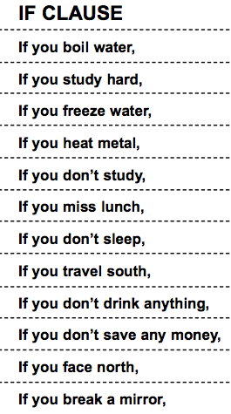



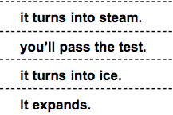
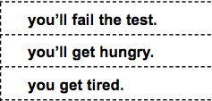
Match the sentences in the first column with those ones in the second column.

Slide 15
Second Conditional: Put the verb into the correct tense.
If he ______(be) younger, he __________ (travel) more.
We ___________(come) to dinner if we _____(have) time.
If we________(not/be) friends, I _________(be) angry with you.
Mary___________(not/ buy) a house if she__________(not/decide) to stay here.

Slide 16
Answers
If he were younger, he would travel more.
We would come to dinner if we had time.
If we weren’t / were not friends, I would be angry with you.
Mary would not buy a house if she didn’t decide to stay here.

